Slide 1
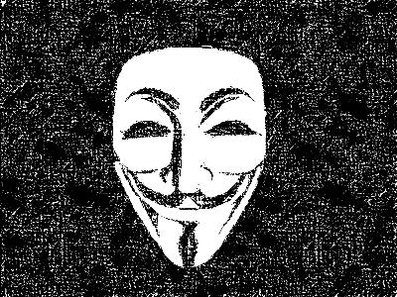
Anonymous: Cyber Terrorists or Internet Saviors?
Ryan Jacobs

Slide 2
What is Anonymous?
Anonymous is a group of activists and hacktivists that spread across the globe
The word hacktivist is a combination of “hack” and “activist” and is used to describe someone that computers to promote their beliefs.
As you can conclude from their name, anonymity is the foundation of the group

Slide 3
Origin
The concept of Anonymous arose on the notorious website 4chan.
Discussion boards on 4chan were typically used for entertainment.
One discussion board automatically set the name for anyone that posted to “anonymous”
This anonymous board quickly grew popular

Slide 4
Origin cont.
The users of this board would occasionally come together to do mass pranks and raids on various website.
After a couple of these online raids there was a press story covering Anonymous calling them “hackers on steroids”.
Since then Anonymous became an official group and has been expanding.

Slide 5
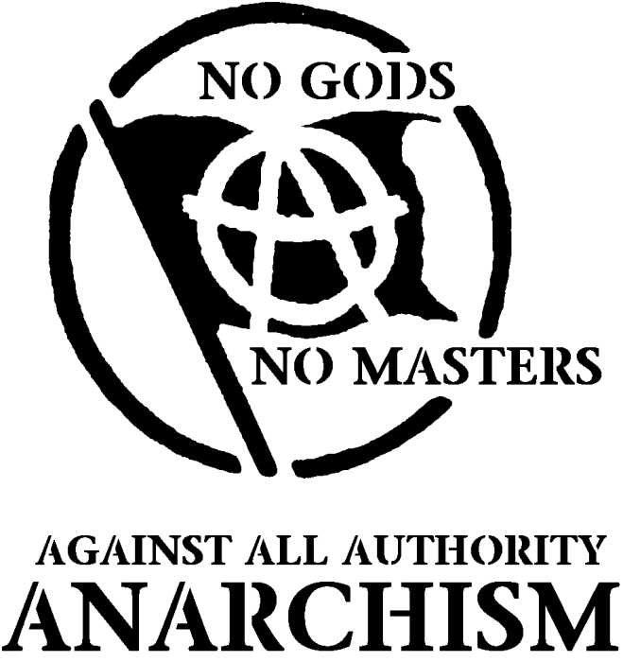
Philosophy
The websites and organizations Anonymous attack seems sporadic but it seems they have a system of beliefs
They are against anti-piracy campaigns, child pornography, Westboro Baptist Church and anything else they deem unmoral

Slide 6
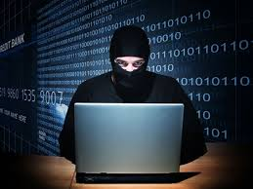
Anonymous as Villains
Many people view Anonymous as threats instead of heroes
They see the group as immature kids messing with people on the internet
The actions of the hackers have not been pure
There have been cases of harassment, stolen information, releasing people’s personal information to the public, and much more

Slide 7
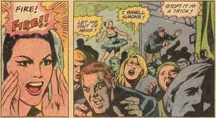
Bomb Threats
In 2006 an anonymous member threatened to detonate bombs at seven NFL stadiums
He never actually intended to set off any bombs; he just wanted to scare a large amount of people

Slide 8
Cyber Bullying
Back in the day when Myspace was popular Anonymous members would using their hacking skills to get onto a person’s profile who they didn’t like and post inappropriate things and images
They had nothing to gain from this, and there was no motive other than their dislike for the victim

Slide 9
Aaron Barr Attack
Aaron Barr, the CEO of a computer security firm, researched Anonymous and threatened to expose members of the group.
In February 2011 Anonymous retaliated by hacking into his email and making all of his business emails available for download to the public.
The email leak caused quite a stir and Barr ended up resigning shortly after

Slide 10
Sony Gets Targeted
Sony took measures to stop hacking taking place on their gaming console
Anonymous took offense to that and responded by shutting down PlayStation Network for a month
Anonymous had access to over 100 million Sony accounts, some of which included credit card information

Slide 11
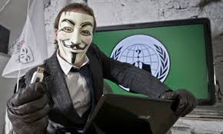
Anonymous as Heroes
Anonymous is unlike most groups
They have no clear-cut leader and are spread out across the globe
There is often disagreement within the group so their actions don’t represent their intentions as a whole
They have done plenty of good actions that has won them supporters

Slide 12
Hal Turner
Hal Turner was a white supremacist radio host
He sued 4chan in January 2007 for copyright infringement
Anonymous took his website offline and used up Turner’s bandwidth which resulted in thousands of dollars in bills

Slide 13
Project Chanology
Anonymous openly attacked the Church of Scientology which was a cult-like religion.
They hacked into their website and displayed anti-scientology material everywhere
They also protested in person at multiple church events

Slide 14
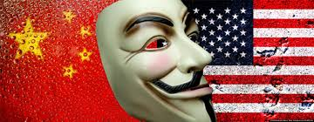
Exposing the enemies
In 2011 Anonymous leaked information on users of a big hacking form which lead the arrest of 11 Chinese men linked to cyber attacks against the U.S

Slide 15
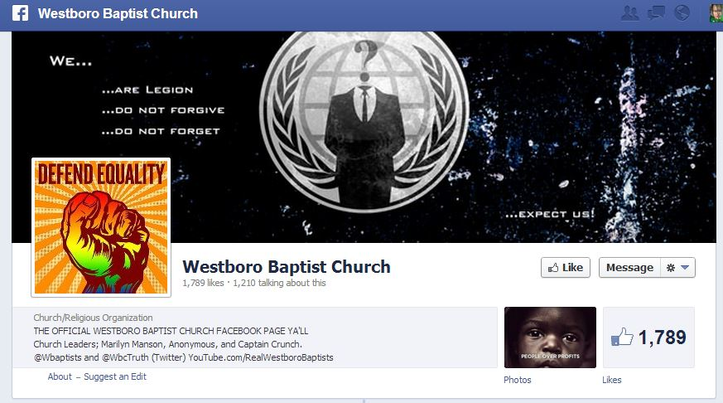
Westboro Baptist Church
Targeting several originations that were accused of homophobia Anonymous’s attack on Westboro was most notable because of the controversy they created by picketing soldier's funerals
Anonymous hacked and brought down the website “GodHatesFags.com”
Petitions were passed around to have the church’s tax-exempt status looked into
They also posted the names, addresses, phone numbers, and emails of the members of the church

Slide 16
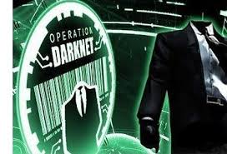
Operation Darknet
Anonymous took a stand and fought against child pornography
Most of these illegal sites hid themselves in the deep internet so Anonymous had to do the work to find them
They terminated around 40 sites and then released 1589 usernames for those sites

Slide 17
Steunbenville Rape Case
In August 2012 a girl in Ohio was raped by several members of a high school football team
Anonymous was really bothered because the school tried to cover it up to protect the athletes
The hackers dug up and leaked emails, tweets, and even videos that incriminated the football players and helped in their conviction

Slide 18
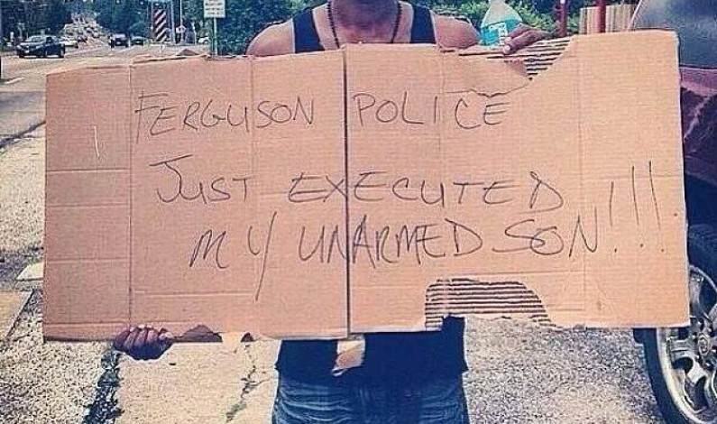
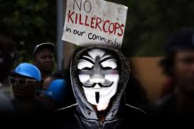
The Ferguson Shooting
Following the shooting of an unarmed man by a police officer Anonymous vowed to discover the identity of the shooter
They hacked into the Ferguson servers and official’s emails
They posted a name of the suspected killer, but the police claimed that they had the wrong name

Slide 19
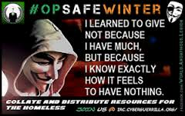
Operation Safe Winter
Anonymous launched a campaign to raise awareness about people that live on the streets
They organized different events to help out like clothing drives and community potlucks

Slide 20
Fight Against Government
During the revolution in Tunisia and Egypt Anonymous aided the protesters
They provided the protestors with a way to use their internet without government surveillance
They also attacked government websites, shutting them down.
Anonymous helped spread awareness of what was happening by sharing videos about the revolution

Slide 21
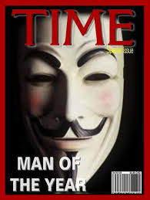
The Good prevails
Despite the face Anonymous has committed some selfish, unmoral acts they have done more than enough to make up for it
Most of the questionable acts were committed when the group was first formed which shows how they have matured and become more organized
They have received praise from many people, one of the most notable being Time Magazine naming Anonymous one of the “100 most influential people” in the world

Slide 22
Sources
http://mic.com/articles/3106/the-dark-side-of-anonymous-everything-you-never-knew-about-the-hacktivist-group
http://www.businessinsider.com/good-hacks-by-anonymous-2013-4#1-just-this-month-anonymous-began-operation-free-korea-its-the-groups-effort-to-get-controversial-leader-kim-jong-un-to-resign-install-free-democracy-abandon-nuclear-ambition-and-grant-uncensored-internet-access-to-its-citizens-on-april-3-anonymous-released-all-15000-usernames-and-passwords-for-the-governments-web-services-and-threatened-to-wipe-its-data-8
http://www.mercurynews.com/top-stories/ci_18686764
http://www.cbc.ca/news/canada/from-anonymous-to-shuttered-websites-the-evolution-of-online-protest-1.1134948
http://www.theatlantic.com/technology/archive/2010/12/what-its-like-to-participate-in-anonymous-actions/67860/
http://www.wired.com/2012/06/anonymous-parmy-olson-review/all/
http://www.highbeam.com/doc/1G1-175951837.html

